Slide 1
EudraCT Project
Simon Bond 16th September 2019

Slide 2
EudraCT
Historically many studies did not report their results anywhere
Biases evidence synthesis
Studies are repeated
Bad Pharma – Ben Goldacre
Now all CTIMP studies must
Register to be able to start
Enter the results within 1-year of finishing (6 months for paediatric)
There is a clunky Web portal as the interface

Slide 3
EudraCT Results
Trial Information
Design
Remit
Who, where, when etc.
Baseline Demographics
Primary analysis
Safety Data

Slide 4
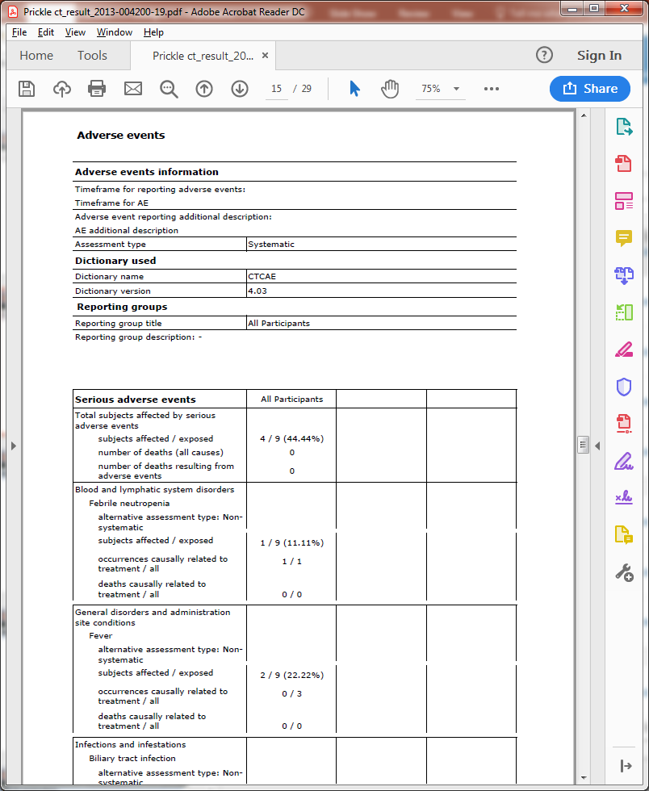
Final Report from EudraCT

Slide 5
Safety Data by hand
For each term and arm:
Term
System Organ Class
Number of Patients
Number of Occurrences
Number of Related Occurrences
Deaths
Related Deaths

Slide 6
Elevator Pitch
All CTIMP studies are required to enter results into EudraCT within 1 year of completion
Detailed safety results could take 1000s of hours to enter by hand
Or upload an XML with the data in seconds.

Slide 7
Diversion: what is XML
<body> <h1>This is a Heading</h1> <p>This is a paragraph.</p> </body>
A set of rules to make rules.
A specific xml file captures information within a structure.
Some other piece of software needs to know the specific rules to then process the information

Slide 8
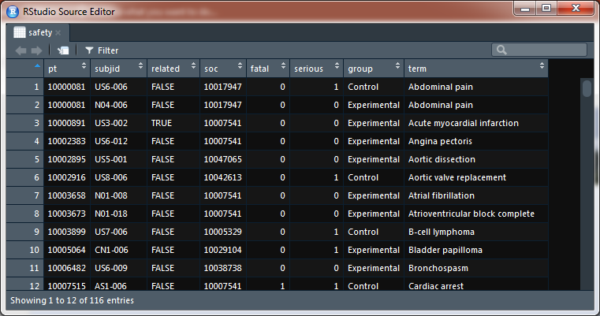
Input Data

Slide 9
Tools
https://eudract-tool.medschl.cam.ac.uk/
R package – 3 lines of code
SAS code files in a zip folder
Stata code files in a zip folder

Slide 10
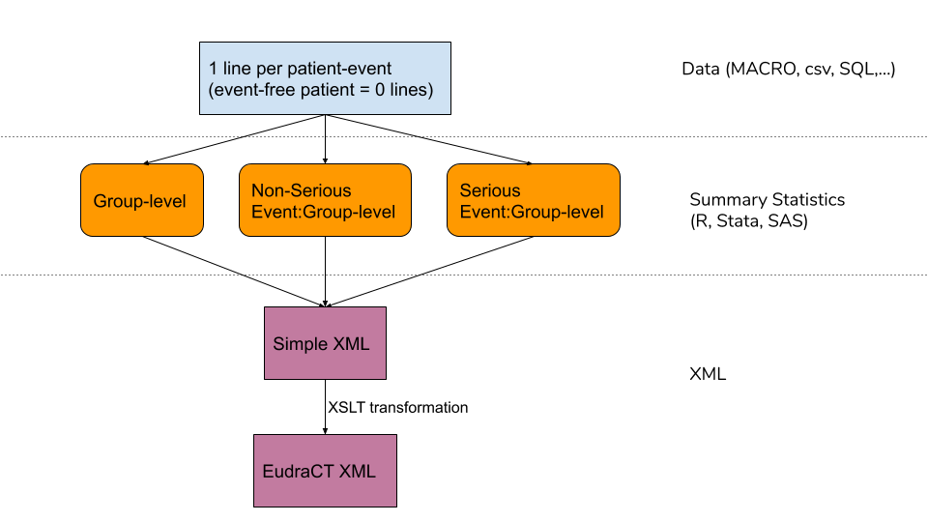
Flow Chart of process

Slide 11
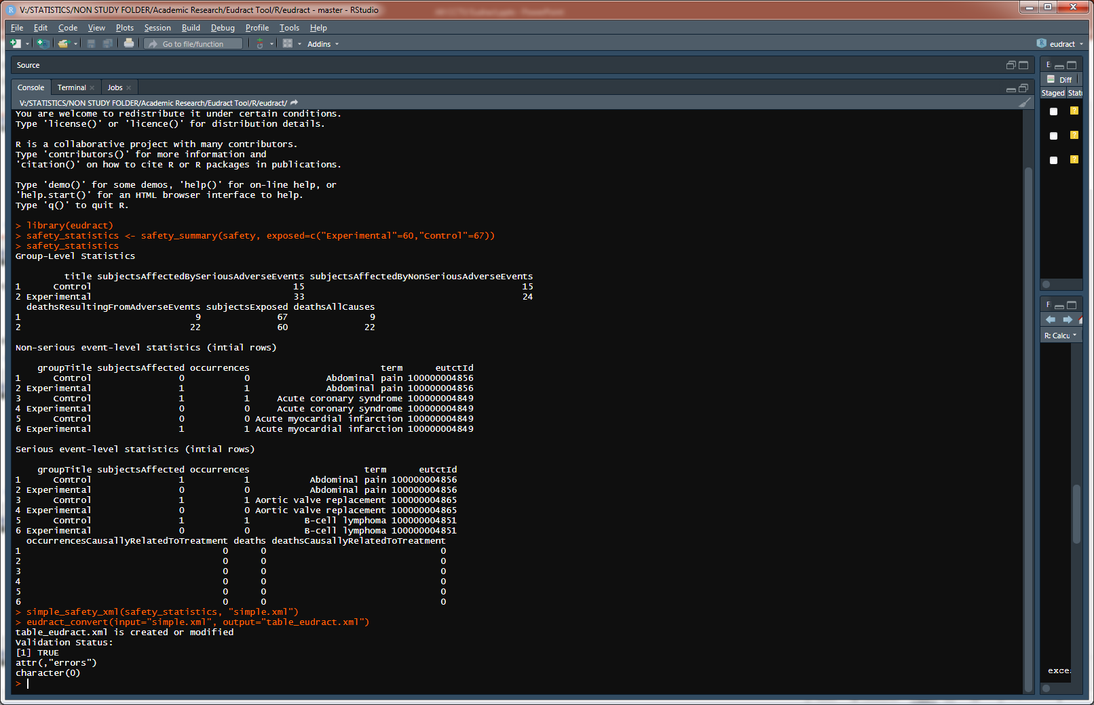
R code example

Slide 12
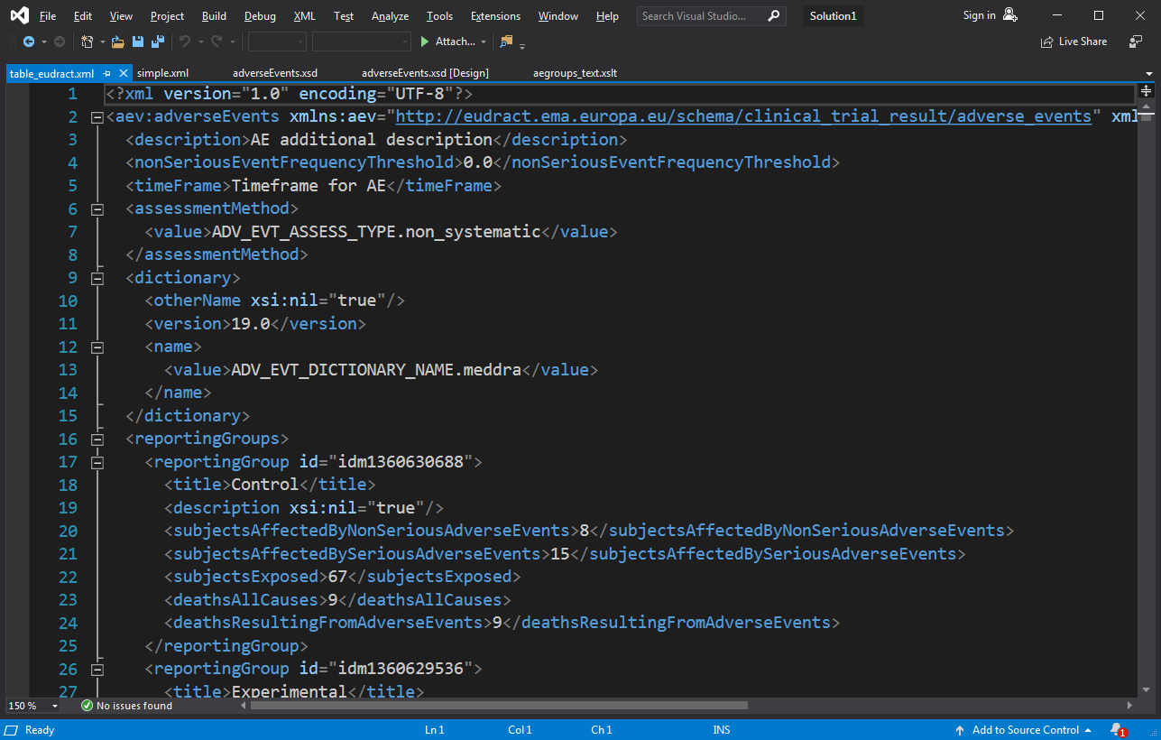
Final Output

Slide 13
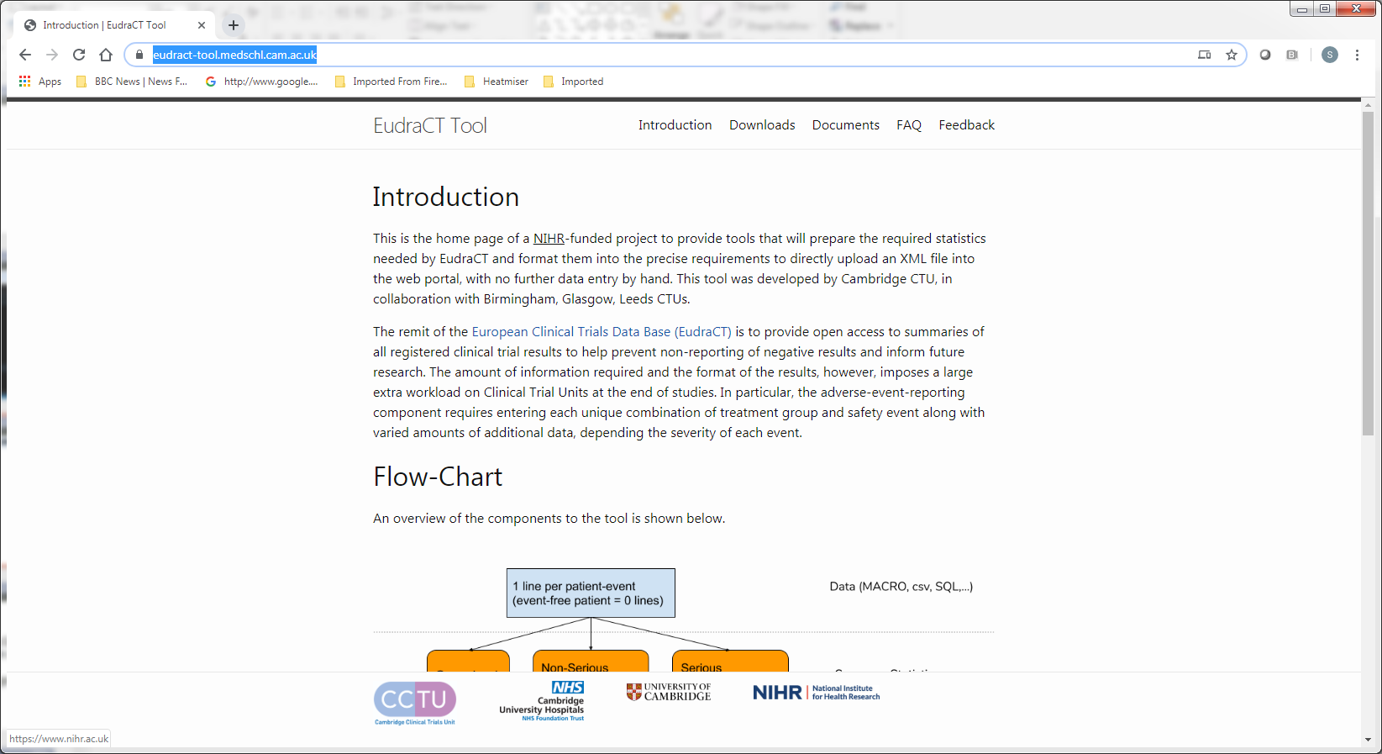
https://eudract-tool.medschl.cam.ac.uk

Slide 14
Project Status
Website ongoing
Code is directly accessible using Github
Poster at ICTMC Brighton in October
Validation and testing ongoing
Journal Article
Training

Slide 15
Questions?

Slide 16
Spare Slides

Slide 17
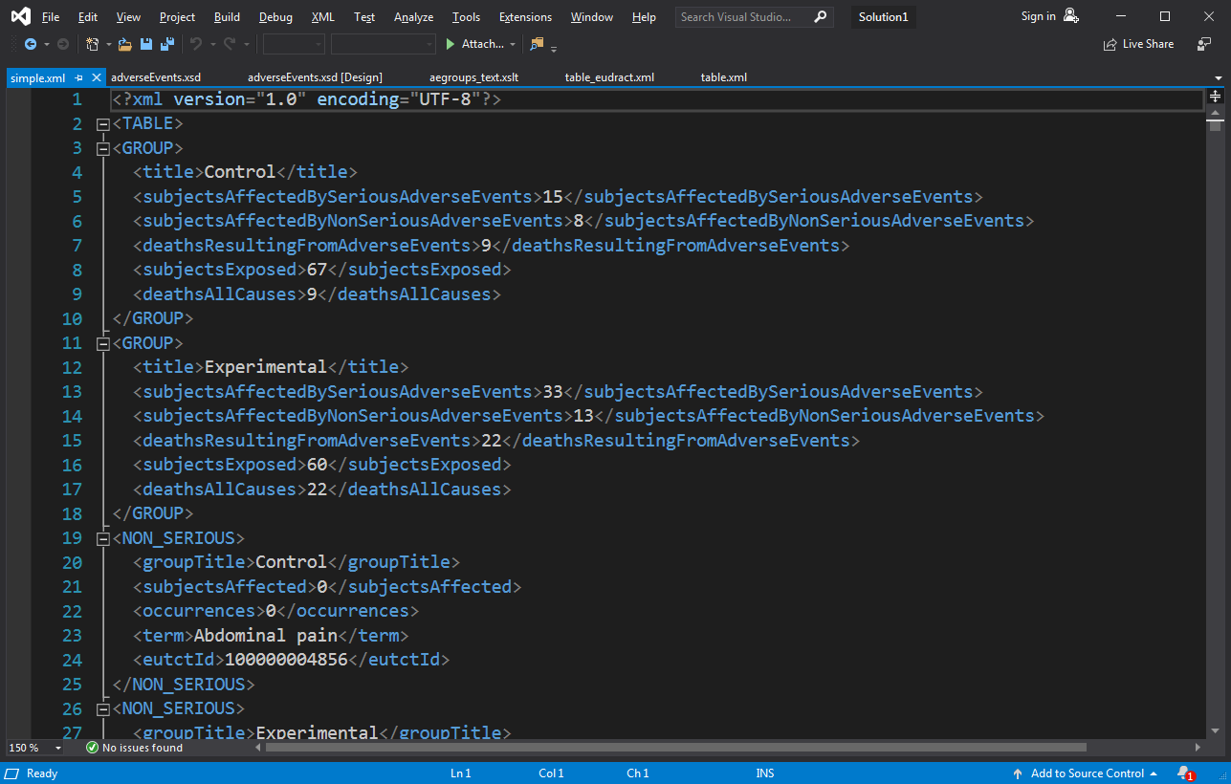
Save in Simple xml with standard names

Slide 18
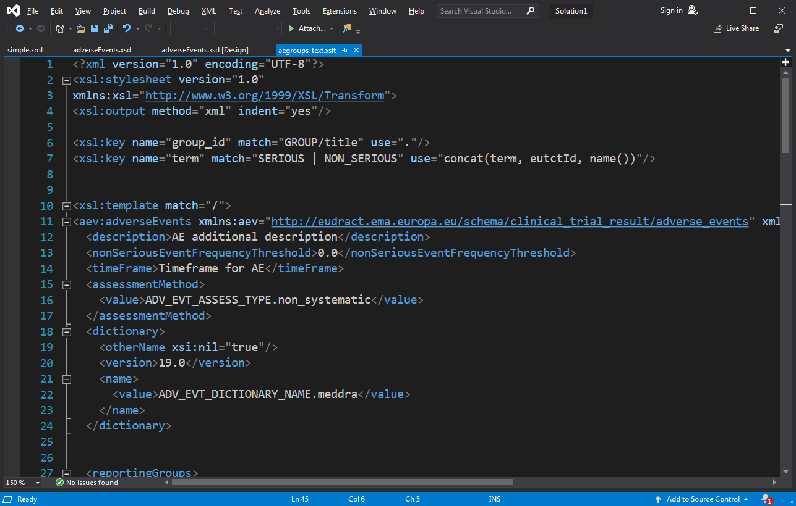
Transformation code: 108 lines

Slide 19
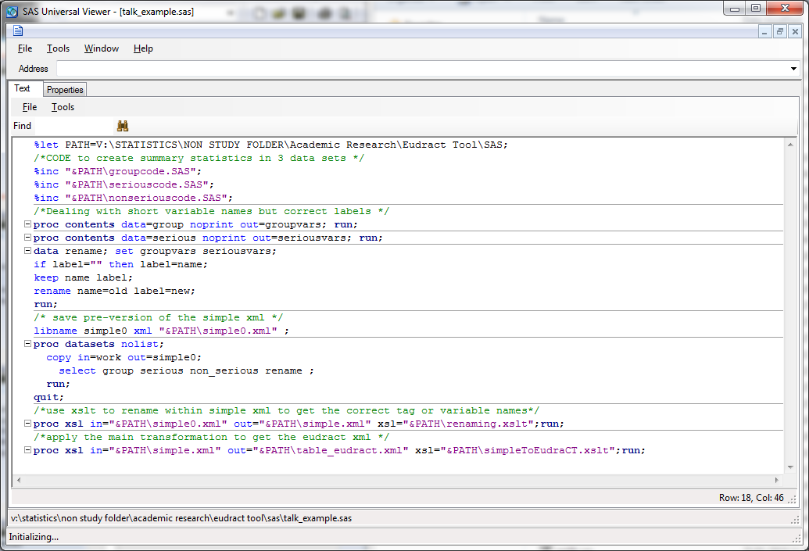
SAS Equivalent

Slide 20
Unification across R/SAS/Stata
Could export directly writing output mixing text and data
Print (“<blah>”, count[i,j], “</blah>”)
But: one unified XSLT stage for the details
Easy to amend for future changes
Open-source code on GitHub for anyone to propose amendments
Leaves the statisticians to do statistics
Need to export into “Simple” XML from Stata

Slide 21
Test overview
Use the training version of EudraCT
Take a past trial already uploaded to EudraCT from another CTU, and compare output
Unit testing within R, Stata,SAS.
Feedback from other units welcome

Slide 22
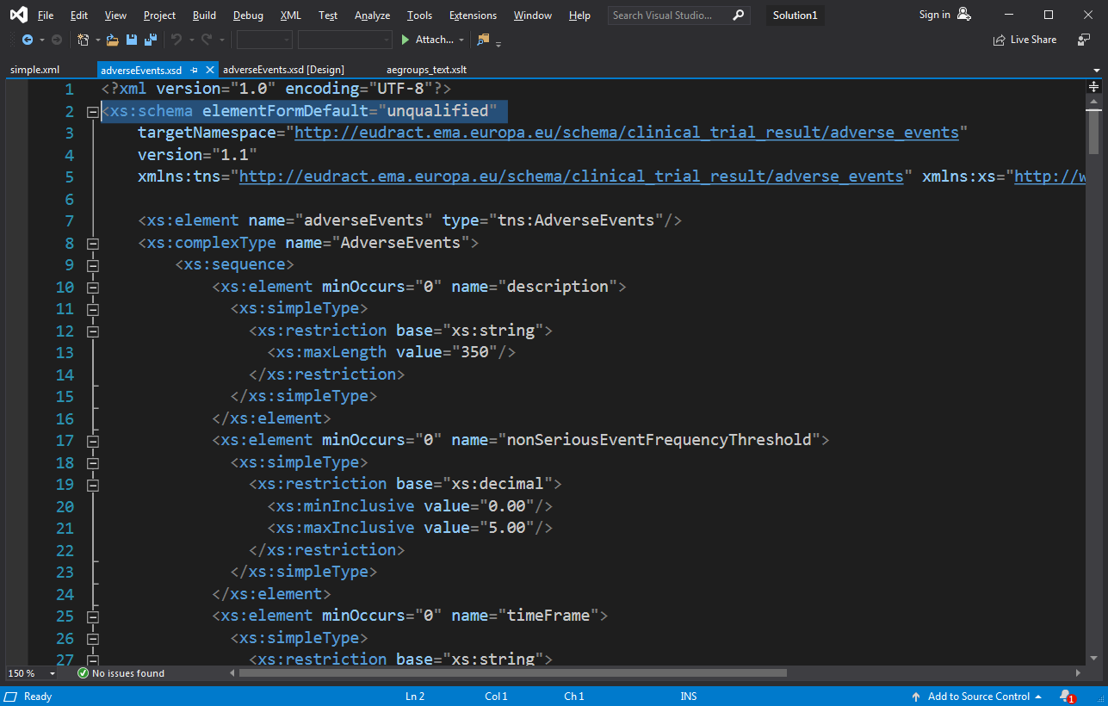
Schema downloaded from EudraCT

